Slide 1
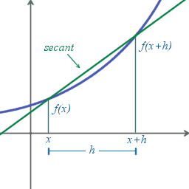
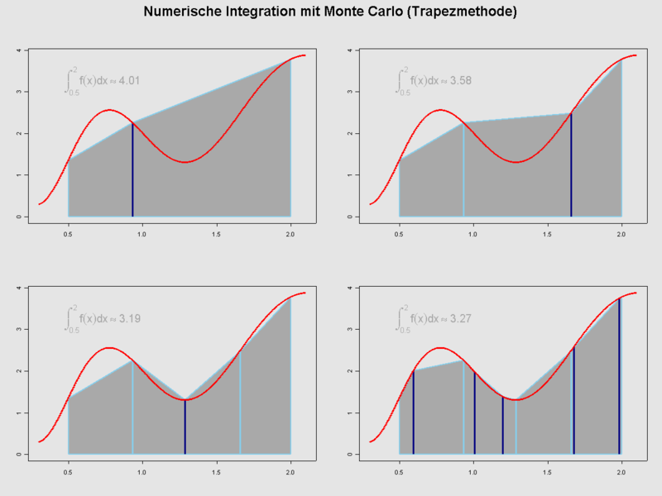
Numerical Differentiation and Integration (2)

Slide 2
Integration
For f: R→R, definite integral over interval [a, b],
is defined by the limit of Riemann sums
Riemann integral exists if integrand f is bounded and continuous almost everywhere

Slide 3
Numerical Quadrature
Numerical approximation of definite integrals is known as numerical quadrature
Numerical quadrature computes the areas of curved figures
In our case: area under a curve over an interval

Slide 4
Quadrature Rule
Quadrature rule is a weighted sum of finite number of sample values of integrand function
Main issues
How to choose sample points
How to weight their contributions
to obtain a desired level of accuracy
Computational cost measured by the number of evaluations of integrand function required
node
weight

Slide 5
Quadrature Rule (cont.)
Quadrature rules based on polynomial interpolation
Integrand function f sampled at a finite set of points
Polynomial interpolant at those points is determined
Integral of interpolant taken as an estimate for integral of original function
In practice, interpolating polynomial is not determined explicitly but just used to determine the weights corresponding to samples

Slide 6
Numerical Quadrature (cont.)
Newton-Cotes Formulas:
Trapezoidal rule—linear interpolation
Simpson’s 1/3 rule—quadratic interpolation
Simpson’s 3/8 rule—cubic interpolation
Other methods:
Gaussian quadrature
Method of undetermined coefficients

Slide 7
Numerical Integration—Trapezoidal Rule
Approximate the curve with a sequence of straight lines
f_{i+1}
f_{i}
x_{i-1}
x_{i}
x_{i+1}
x_{i+2}

Slide 8
Error Estimation for Trapezoidal Rule
Recall that the formula for interpolating (x_{i}, f_{i}) and (x_{i+1}, f_{i+1}) using function differences is
f”(ξ) is approximately a constant for small h

Slide 10
Composite Trapezoidal Rule
Subdivide [a, b] into n smaller intervals △x = h
Global error is the sum of n local errors

Slide 11
Trapezoidal Rule for Unevenly Spaced Data
Suppose there are five points

Slide 12
Romberg Integration
Apply Richardson extrapolation to numerical integration

Slide 13
Example: Integral of f(x)=exp(-x²), x in [0.2, 1.5]
1st estimation: h=(b-a)/2=0.65
2nd estimation: h=0.65/2=0.325
Improved = 0.65947+1/3*(0.65947-0.66211)
Only needs two new
function evaluations

Slide 14
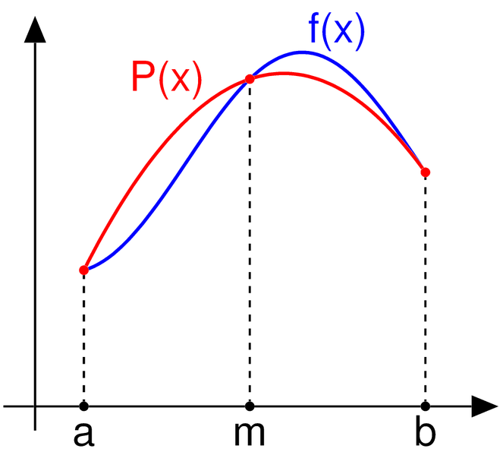
Simpson’s Rule
Approximates the function with a quadratic or cubic interpolation polynomials
Simpson’s 1/3 rule—quadratic interpolation

Slide 15
Simpson’s Rule
Approximates the function with a quadratic or cubic interpolation polynomials
Simpson’s 1/3 rule—quadratic interpolation
Simpson’s 3/8 rule—cubic interpolation

Slide 16
Simpson’s 1/3 Rule

Slide 17
Error Estimation for Simpson’s 1/3 rule
Write the polynomial up to the 4th order as the 3rd order term will vanish in the integral
Notes:
Originally, a third-order error term is used when a 2nd polynomial is used to interpolate the integrand function; however, since the third-order term vanishes after integration. Therefore, we use the 4th order error term to estimate the error of the Simpson’s 1/3 rule.

Slide 18
Simpson’s 1/3 rule for multiple segments

Slide 19
Simpson’s 3/8 Rule
Approximating f(x) by cubic interpolation
Prove the following by yourself

Slide 20
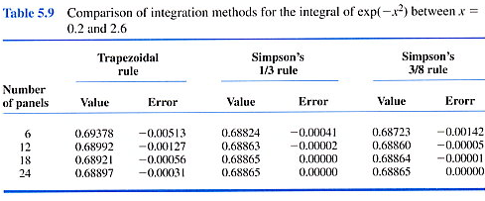
Example: Integral of f(x)=exp(-x²) between a = 0.2 and b = 2.6

Slide 21
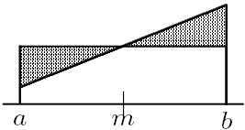
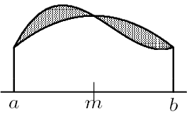
Accuracy of Newton-Cotes Quadrature
In general, odd-order Newton-Cotes rule gains extra degree of accuracy beyond that of polynomial interpolant on which it is based
This is due to cancellation of positive and negative errors
f(x) ≈ P₀(x)
f(x) ≈ P₂(x)

Slide 22
Drawbacks of Newton-Cotes Quadrature
Newton-Cotes quadrature rules are simple and often effective, but they have drawbacks
Using large number of equally spaced nodes may incur erratic behavior associated with high-degree polynomial interpolation (e.g., weights may be negative)
Newton-Cotes rules are not of highest degree possible for number of nodes used

Slide 23
Method of Undetermined Coefficients
Same game as we did in numerical differentiation
Illustrated by the following example
Case 1: P(x)=1, f₁=1, f₂=1
Case 2: P(x)=x, f₁=P(0)=0, f₂=P(h)=h

Slide 24
Solving for Coefficients
Trapezoidal Rule

Slide 25
Example: derive Simpson’s 1/3 rule using method of undetermined coefficients

